Slide 1
CURVE
REPRESENTATION

Slide 2
Representation
Non-parametric form: y = f(X)
Implicit form: f(x, y) = 0
Explicit form: y = mx + b
Parametric form: x = x(t)
y = y(t)

Slide 3
2nd degree implicit representation:
ax² + 2bxy + cy² + 2dx + 2ey + f = 0
Any guess, why the factor 2 is used ?
This form of the expression, with the coefficients, provide a wide variety of 2D curve forms called:
CONIC SECTIONS

Slide 4
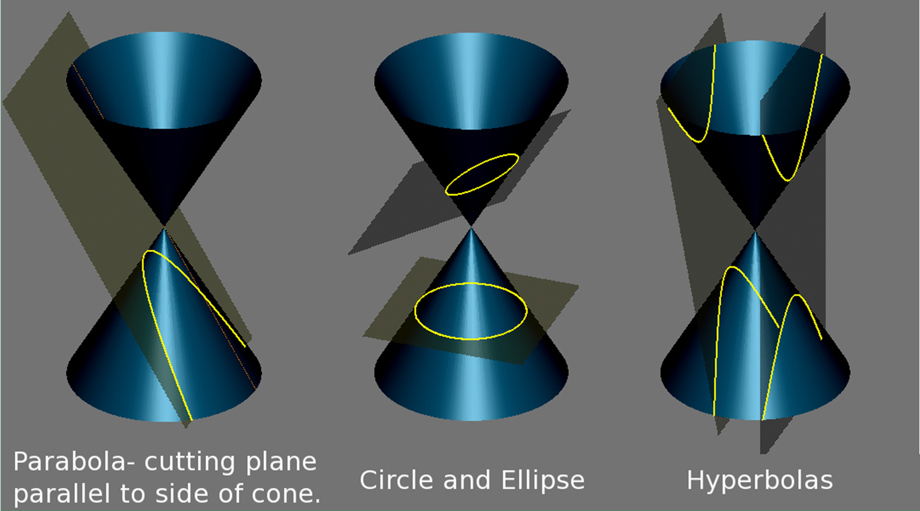

Slide 5
y
M
P(x, y)
O
F(a, 0)
x
y
M
P(x, y)
PARABOLA
directrix x= -a
O
F(ae, 0)
x
directrix
HYPERBOLA
x= -a/e
directrix x= a/e

Slide 6
y
P(x, y)
O
F(-ae, 0)
x
F(ae, 0)
directrix x= -a/e
directrix x= a/e
ELLIPSE

Slide 7
CONIC SECTIONS
PARABOLA
HYPERBOLA
ELLIPSE
y² = 4ax; a > 0
Focus : (a, 0); Directrix = −a. eccentricity, e = 1
x = at² ; y = ±2at.
or
x = tan² (φ);
y = ±2 a tan(φ).
_{x} 2 _{− y}2
_{x} 2 _{+ y}2
_{a} 2 _{b}2
= 1;
= 1;
_{a} 2 _{b}2
b² = a ² (e² − 1);
e > 1; Foci : (±ae,0). Directrices : x = ±a / e; x = a sec(t ),
y = b tan(t );
− π / 2 < t < π / 2.
Rectangular Hyperbola :
e = 2;x = ct; y = c / t.
a ≥ b > 0.
b² = a ² (1 − e² );
0 ≤ e ≤ 1.
Foci : (±ae,0); Directrices : x = ±a / e. x = a cos(t ),
y = b sin(t );
t ∈ [−π ,π ].

Slide 8
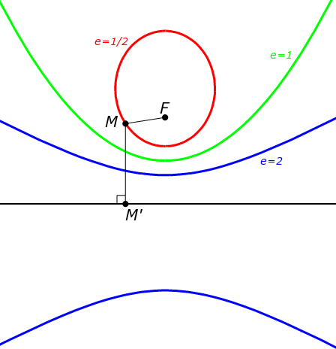
Ellipse (e=1/2), parabola (e=1) and hyperbola (e=2) with fixed focus F and directrix.
For circle, e = 0.
??

Slide 9
e.L
1+ e cos(θ )
Polar Equation of a conic (home assignment):
r =
, where, L = dist(F , d )
F – Focal Point; d – Directrix;
e – Eccentricity.
Condns: Focal point at Origin;
e.L = l; is called the “semi-latus rectum”.

Slide 10
ax² + 2bxy + cy² + 2dx + 2ey + f = 0
If the conic passes through the origin: f = 0.
Assuming, one of the parameters to be a constant, c = 1.0, f = 1.0
Remaining 5 Coeffs. may be obtained using 5 geometric conditions:
Say:
Boundary Conditions -
– two (2) end points
slope of the curves at two (2) end points. and
one (1) intermediate point

Slide 11
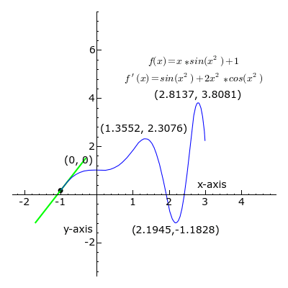

Slide 12
ax² + 2bxy + cy² + 2dx + 2ey + f = 0
Generalized CONIC
Re-organize:
as XSX ^{T} = 0,
S is symmetric
⎡a b
⇒ [x y 1]⎢b c
e
^{d} ⎤ ⎡ ^{x}⎤
e ⎥ ⎢ y⎥ = 0
⎢
⎢_{⎣d}
⎥ ⎢ ⎥
_{f} ⎥⎦ ⎢_{⎣1} ⎥⎦
or
XAX ^{T} + GX + f = 0

Slide 13
Special Conditions:
If b² = ac, the equation represents a PARABOLA;
If b² < ac, the equation represents
an ELLIPSE;
If b² > ac, the equation represents
a HYPERBOLA.

Slide 14
SPACE CURVE (3-D)
Explicit non-parametric representation: x = x, y = f(x), z = g(x).
Non-parametric implicit representation: f(x, y, z) = 0, g(x, y, z) = 0.
Intersection of the above two surfaces represents a curve.
Examples:
x = t³ , y = t ² , z = t.

Slide 15
A parametric space curve:
x = x(t), y = f(t), z = g(t).
x = λ[a.cos(θ + π / 4) − b.cos 3(θ + π / 4)], y = μ[a.sin(θ + π / 4) − b.sin 3(θ + π / 4)], z = c.sin(2θ ).
Curve on the seam of a baseball:
λ = 1+ d.sin(2θ ) = 1+ d (z / c),
μ = 1− d.sin(2θ ) = 1− d (z / c);
θ = 2πt,0 ≤ t ≤ 1.0.
where,
x = r.cos(t), y = r.sin(t), z = bt;
b ≠ 0,−∞ < t < ∞
HELIX:

Slide 16
PARAMETRIC CUBIC CURVES
x(t) =
y(t) =
z(t) =
3
2
a t + b t + c t + d
x x x
x,
3
2
a t + b
t + c t + d
y y y y,
3 2
a t + b t + c t + d .
z z z z
Q(t) =[x(t)
y(t)
z(t)]= T.C,
⎡a_{x} a_{y} a_{z ⎤}
⎢_{b}
b
_{b} ⎥
where, T = [t ³
_{t} 2
t 1] and C = ⎢
y z ⎥
x
⎢_{cx}
c_{y}
d_{y}
_{cz} ⎥
⎢
⎥
⎢⎣^{d}x
^{d}z ⎥⎦

Slide 17
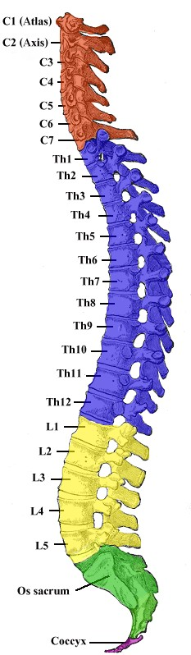
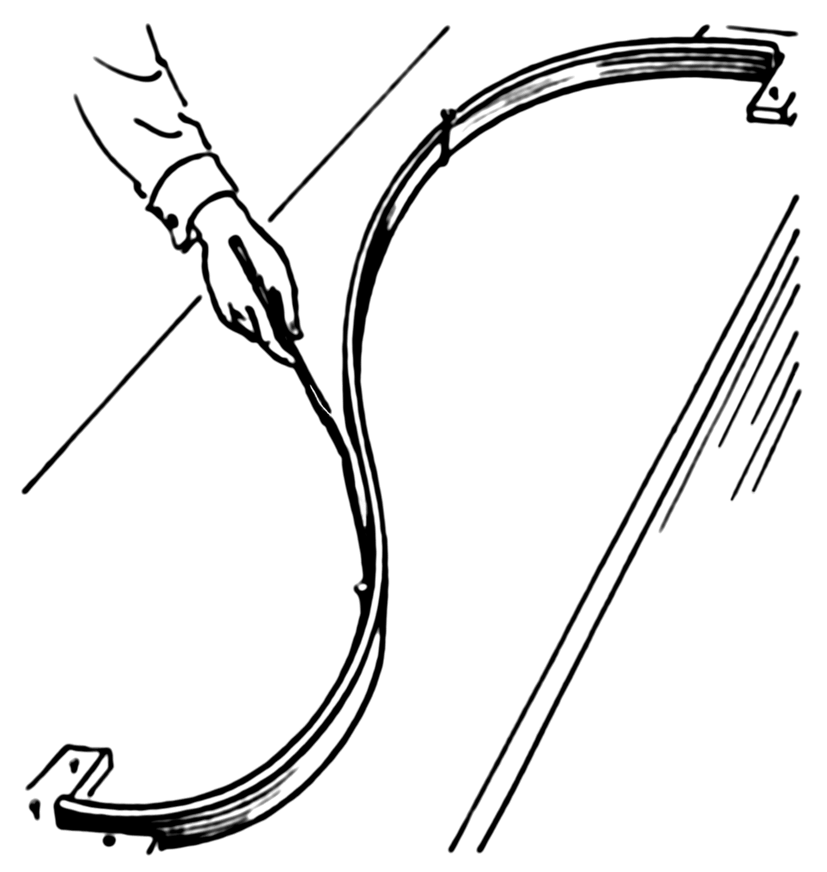

Slide 18
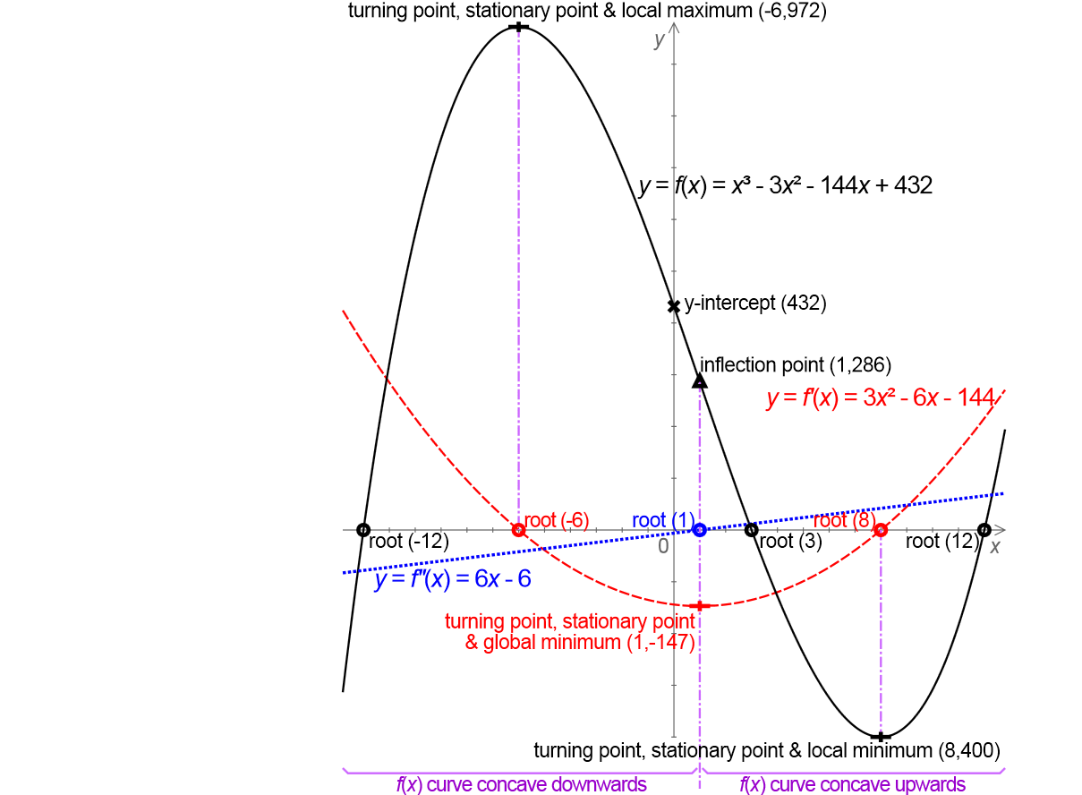
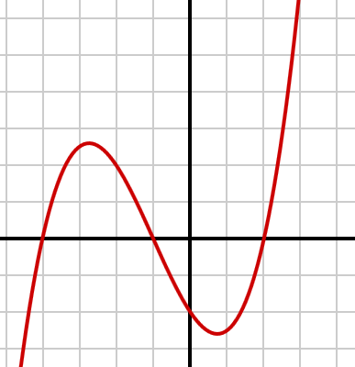
CUBIC CURVE:
- identify geonetrical/mathematical properties

Slide 19
PARAMETRIC CUBIC Splines
x(t) =
y(t) =
z(t) =
3
2
a t + b t + c t + d
Spline curve refers to any composite curve, formed with Polynomial sections, satisfying specific continuity conditions (1st and 2nd derivatives) at the boundary
x x x
x,
3 2
a t + b t + c t + d
y y y y,
3 2
a t + b t + c t + d .
z z z z
of the pieces.
P(t) =[x(t)
z(t)]= T .CF,
y(t)
⎡a_{x} a_{y} a_{z ⎤}
⎢b b
_{b} ⎥
where, T = [t³
_{t} 2
t 1] and CF = ⎢
x y z ⎥
c_{y}
To solve for:
⎢_{cx}
_{cz} ⎥
CF = T ⁻¹P;
⎢_{d}
_{d} ⎥
⎢⎣
d
x y z ⎥⎦
What do you need ??

Slide 20
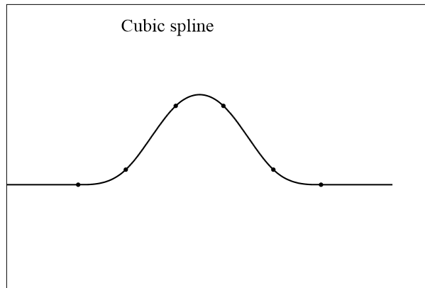
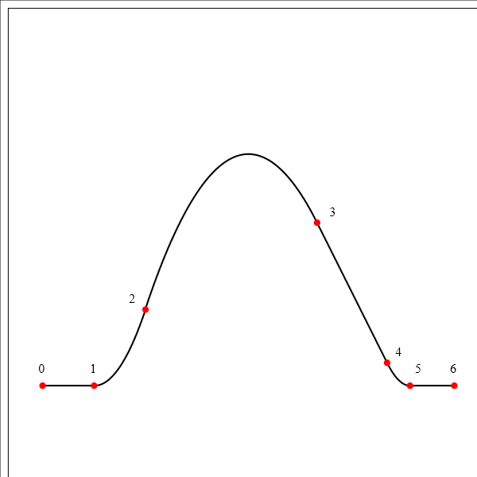
Quadratic spline With 6 Polynomial
segments
With 7 Polynomial segments

Slide 21
P(t) =[x(t)
y(t)
z(t)]= T.CF,
⎡a_{x} a_{y} a_{z ⎤}
⎢ _{b} ⎥
y
c_{y}
where, T = [t³
_{t} 2
t 1] and CF = ^{⎢bx}
b_{z ⎥}
To solve for:
⎢_{cx}
_{cz} ⎥
CF = T ⁻¹P;
⎢_{d}
_{d} ⎥
d
⎣
x y z ⎦
You need four (4) boundary conditions ??
P(t) =At³ + Bt² + Ct + D; 0 ≤ t ≤ 1.
⎡ ^{A}⎤
⎢ _{B}⎥
Hermite Boundary Conditions:
P(t) = [t³ t 1]⎢
_{t} 2
⎥;
⎢_{C} ⎥
⎢_{D}⎥
P(0) = P₀ ; P(1) = P₁;
P'(0) = DP₀ ; P'(1) = DP₁;
⎣ ⎦
⎡ ^{A}⎤
⎢ _{B}⎥
P'(t) = [3t ²
2t 1 0]⎢
⎥;
⎢_{C} ⎥
⎢_{D}⎥
⎣ ⎦

Slide 22
P(t) = At ³ + Bt ²
+ Ct + D; 0 ≤ t ≤ 1.
⎡ ^{A}⎤
⎢ _{B} ⎥
P(0) = P₀ ; P(1) = P₁;
P(t) = [t ³
_{t} 2
t 1]⎢
⎥;
⎢_{C} ⎥
⎢_{D}⎥
P'(0) = DP₀ ; P'(1) = DP₁;
⎣ ⎦
⎡ ^{A}⎤
⎢ _{B} ⎥
P'(t) = [3t ²
2t 1 0]⎢
⎥;
Solve to get:
⎢_{C} ⎥
⎢_{D}⎥
⎣ ⎦
⎡ P(0) ⎤ ⎡0 0 0
1 1
0 1
2 1
¹⎤⎡ ^{A}⎤
⎢₁
₁⎥⎢ _{B}⎥
⎢ P(1) ⎥
⎢ ⎥ ₌ ⎢
⎥⎢ ⎥;
⎢DP(0)⎥
⎢₀
₀⎥⎢_{C} ⎥
⎢
⎥⎢ ⎥
⎢ DP(1) ⎥
⎣3
⎣
⎦
⁰⎦⎣^{D}⎦

Slide 23
⎡ P(0) ⎤ ⎡0 0 0
¹⎤⎡ ^{A}⎤
⎢₁
1 1
0 1
2 1
₁⎥⎢ _{B}⎥
⎢ P(1) ⎥
⎢ ⎥ ₌ ⎢
⎥⎢ ⎥;
⎢₀
⎢ DP(1) ⎥ ⎣3
₀⎥⎢_{C} ⎥
⎢DP(0)⎥
⎢
⎥⎢_{D}⎥
⎣
⎦
⁰⎦⎣ ⎦
⎡0 0 0 1⎤⁻¹ ⎡ P(0) ⎤
1 1 1⎥ ⎢ P(1) ⎥
⎢0 0 1
⎣3 2 1
⎡ ^{A}⎤
⎢_{B}⎥
⎢₁
⎢ ⎥ ₌ ⎢
⎥ ⎢
⎥ = M_{H}G (= CF);
⎢_{C}⎥
0⎥ ⎢DP(0)⎥
⎢ ⎥
⎢
⎥ ⎢ ⎥
⎣^{D}⎦
0⎦ ⎣ DP(1)⎦

Slide 24
In general:
Q(t ) =[x(t )
z(t )] = T .M .G,
y(t )
where, T = [t³
_{t}2
t 1],
M = [m ]
and G = [g g g g ]
T
ij
4 x 4
1 2 3 4
M is a 4x4 basis matrix and G is a four element column vector of geometric constants, called the geometric vector.
The curve is a weighted sum of the elements of the geometry matrix.
The weights are each cubic polynomials of t, and are called the blending functions:
B = T.M.

Slide 25
P(t) = ∑ B t
CUBIC SPLINES
4
P(t) is the position vector of any point on the cubic spline segment.
i −1
;t _{i} ≤ t ≤ t₂ .
i
i =1
P(t) = [x(t), y(t), z(t)]
Cartesian
or [r(t), θ(t), z(t)]
Cylindrical
or [r(t), θ(t), φ(t)]
Spherical

Slide 26
4
x(t) =
∑ ix i =1
4
i −1
B t
y(t) =
∑
i =1
4
B t
i −1
t₁ ≤ t ≤ t₂ .
iy
z(t) =
∑
i =1
B t
i −1
Use boundary conditions
to evaluate the coeficients
iz
P(t) = B₁ + B₂ t + B t
2
3
B t ,
3
4
t₁ ≤ t ≤ t₂

Slide 27

P'(t) = ∑(i − 1 )B_{i} t ^{i − 2}
4
i =1
= B₂ + 2B₃ t + 3B₄ t ²
P₂’
P₂, t₂
P₁’
Let, t₁=0:
P₁, t₁
P( 0 ) = P₁ ; P(t₂ ) = P₂ . P'( 0 ) = P₁'; P'(t₂ ) = P₁'.

Slide 28
B = P ; B = P ;
'
1
1 2 1
Solutions:
B + B t + B t +
B t = P(t );
2
3
1
2 2 3 2 4 2
2
'
B + 2B t + 3B t = P (t
);
2
2
3 2 4 2
2
3(P − P ) 2P
' '
P
B₃ =
2 1
−
1
−
2
;
_{t} 2
t
t
2
2
2
2(P − P ) P
' '
P
B₄ =
1 2
+
1
+
2
;
_{t} 3
_{t} 2
_{t} 2
2
2
2

Slide 29
Equation of a single cubic spline segment:
' '
'
3(P − P ) 2 P
P
P ( t ) = P + P t
+ [
2 1
−
1
−
2
]t
2
1 1
_{t} 2
t
t
2 2
2
2(P − P ) P
'
P
'
+ [
1 2
+
1
+
2
]t ;
_{t} 3
_{t} 2
_{t} 2
3
2
2
2
Rewrite as:
3
P(u) = ∑ g_{k} H_{k} (u)
k =0
P ( t ) = P₁ ( 2 t ³
− 3 t ²
t ) + P ( t
+ 1) + P₂ ( − 2 t ³ + 3 t ² )
' 3
' 3
P
( t − 2 t ²
− t ² )
1
2
Various other approaches used are:
Normalized Cubic splines
Blending
Weighting functions.

Slide 30
Equation of a normalized cubic spline segment:
B = T.M ;
P(t) = T.M .G =
⎡ 2 − 2 1 1 ⎤⎡ P_{k}
⎢ 3 − 2
⎢ 0 0 1
⎣ 1 0 0
Use, t₂ = 1;
⎤
_{1]⎢}− 3
⎥⎢ ⎥
= [t ³
_{t} 2
⁻¹⎥⎢ ^{P}k +1 ⎥
t
₀ ⎥⎢ _{Pk '} ⎥
⎢
⎥⎢ ⎥
⁰ ⎦⎣^{Pk +1 '}⎦
Remember, The derivation:
⎡ ^{A}⎤
⎡0 0 0 1⎤⁻¹ ⎡ P(0) ⎤
1 1 1⎥ ⎢ P(1) ⎥
⎢0 0 1
⎣3 2 1
⎢_{B}⎥
⎢₁
⎢ ⎥ ₌ ⎢
⎥ ⎢
⎥ = M_{H}G (= CF);
⎢_{C}⎥
1⎥ ⎢DP(0)⎥
0⎦ ⎣ DP(1)⎦
⎢ ⎥
⎢
⎥ ⎢ ⎥
⎣^{D}⎦

Slide 31
Equation of a single cubic spline segment:
3(P − P ) 2 P
'
P
'
'
P ( t ) = P + P t + [
2 1
−
1
−
2
]t
2
1 1
_{t} 2
t
t
2 2
2
2(P₁ − P₂ )
_{P}' _{P}'
+ [
+ ¹ + ² ]t ³ ;
_{t} 3
_{t} 2 _{t} 2
2 2 2
P(t) =[x(t)
y(t)
z(t)]= T.M .G = B.G,
where, T = [t³
_{t} 2
t 1], M = [m ]
ij
4 x 4
and G = [g
g₂ g₃ g ] ;
T
1 4
For piece-wise continuity for complex curves, two or more curve segments are joined together.
In that case, use second derivative P₂’’(t) at end-points (joints).

Slide 32
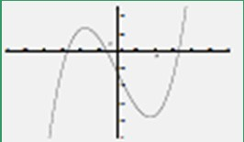
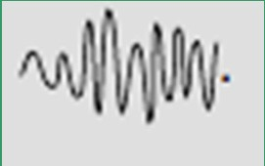
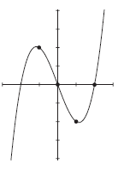
Cubic Polynomial - why and how ?
The degree three polynomial - known as a cubic polynomial
- is the one that is most typically chosen for constructing smooth curves in computer graphics.
It is used because:
1. it is the lowest degree polynomial that can support an inflection
- so we can make interesting curves, and
2. it is very well behaved numerically - that means that the curves will usually be smooth like this:
and not jumpy like this:
control points: (-1, 2); (0, 0); (1, -2); (2, 0)
Solution for the Coefficients can be given as:
⎡ª ⎤
⎢_{b} ⎥
⎢ ⎥ ₌
⎢_{c} ⎥
⎡1 −1 1 −1⎤⁻¹ ⎡ 2 ⎤
⎢ ⎥ ⎢ ⎥
⎢1 0 0 0 ⎥ ⎢ 0 ⎥
⎢1 1 1 1 ⎥ ⎢− 2⎥
⎢ ⎥ ⎢ ⎥
⎣1 2 4 8 ⎦ ⎣ 0 ⎦
⎢_{d} ⎥
⎣ ⎦

Slide 33
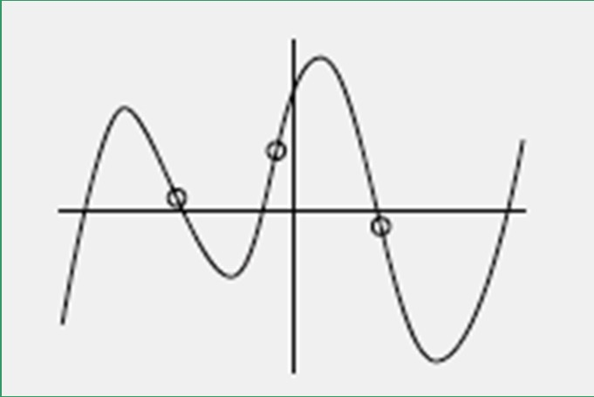
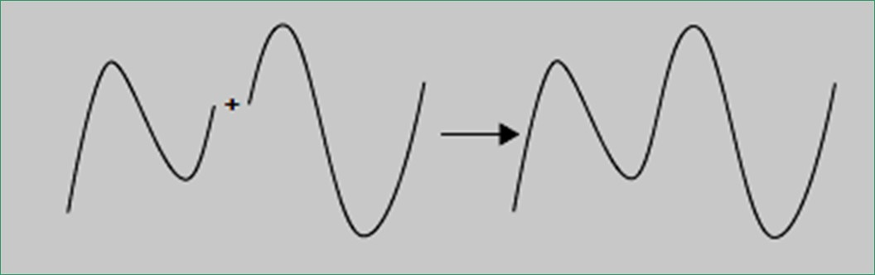
What do we do here – even 3rd degree is insufficient.
3
What about degree five, with how many extra control points ??
Three factors in the design:
Actual Degree/order in the response of the system ??
No. of Control Points
Degree of the Polynomial ?
Piecewise polynomial curves:

Slide 34
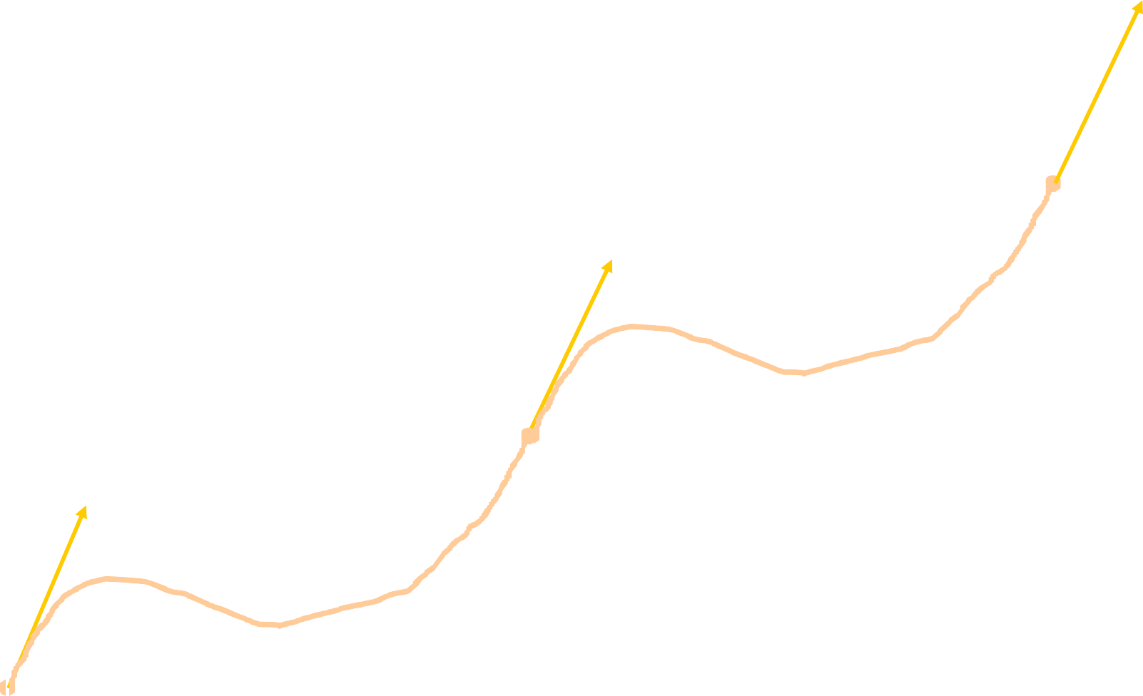
P₁’ and P₃’ known, But what about P₂’ ?
P''(t) = ∑(i − 1 )(i − 2)B_{i} t ^{i − 3}
i =1
= 2B₃ + 6B₄t
4
P ’
3
P₃, t₃
P₂’
P₂, t₂
At the beginning of the second segment :
P₁’
P" = 2B ;
P₁, t₁
(t=0)
3

Slide 35
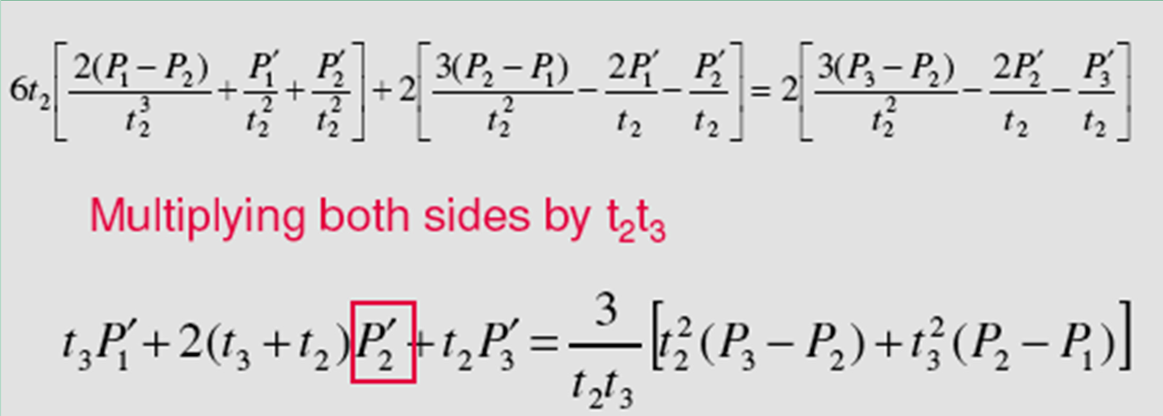
P''(t ) = 2B + 6B t = P"( 0 ) = 2B₃ 2 3 4 2
3(P −
P ) 2P
' '
P
B₃ =
2
1
−
1
−
2
;
_{t} 2
t
t
2
2
2
2(P − P ) P
' '
P
B =
1
2
+
1
+ ;
2
4
_{t} 3
_{t} 2 _{t} 2
2
2
2
⎡2(P₁ − P )
_{P}' _{P}' ⎤
⎡3(P − P ) 2P'
_{P}' ⎤
^{⎡3(P}₃ ^{− P}₂⁾ 2P'
_{P}' ⎤
6t
⎢ ² ₊ ¹ ₊ ² ⎥ ₊ ₂⎢ ² ¹ ₋ ¹ ₋ ² ⎥ ₌ ₂⎢ ₋ ² ₋ ^{3 ⎥}
2 ⎢
_{t}3 _{t}2
_{t2} ⎥ ⎢
_{t}2
_{t2} ⎥ ⎢⎢
⎣ ³
_{t3} ⎥
t₂
_{t}2
t₃
⎢⎣ 2 2
2 ⎥⎦ ⎢⎣ 2
⎥⎦
⎥⎦

Slide 36
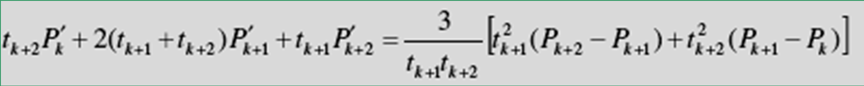
Generalized equation for any two adjacent cubic spline segments, P_{k}(t) and P_{k+1}(t) :
For first segment:
3(P_{k + 1} − P_{k} ) 2 P'
k ₋ ^{P'}+ 1
P (t ) = P
'
P t + [
−
^{k} ]t
2
k k
k
_{t} 2
t
t
k + 1
k + 1
k + 1
_{+ [} 2(P_{k} − P ) P
' '
P
k + 1
+
k
+
k
]t ;
_{t} 3
+ 1
3
_{t} 2
_{t} 2
k + 1
k + 1 k + 1
For second
3(P − P ) 2P'
_{P}'
segment: _{P}
(t ) = P + P
'
t + [
k + 2 k +1
₋ k +1
₋ k + 2 _{]t 2}
k +1
k +1
k +1
_{t} 2
t
t
k + 2
k + 2
k + 2
2(P
P
) P
'
P
'
+ [
k +1
k + 2
+
k 1+
+
k
]t ;
_{t} 3
+ 2
3
_{t} 2
_{t} 2
k + 2 k + 2
k + 2
Curvature Continuity ensured as:

Slide 37
Equation of a normalized cubic spline segment:
F = T.N;
P(t) = T.N.G =
Use, t₂ = 1;
⎡ 2 − 2 1 1 ⎤⎡ P_{k}
⎢− 3 3 − 2
⎢ 0 0 1
⎣ 1 0 0
⎤
⎥
= [ t ]
−1⎥⎢ P
k +1 ⎥
_{t} 3 _{t} 2
₁ ⎢
⎥⎢
₀ ⎥⎢ _{Pk '} ⎥
⎢
⎥⎢ ⎥
⁰ ⎦⎣^{Pk +1 '}⎦
For curvature Continuity:
P '+
4P
'
P
'
= 3[P − P ]
k
k +1
k +2
k +2
k

Slide 38
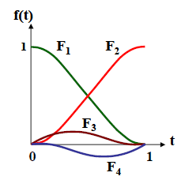
P ( t ) =
P ( 2 t
3
− 3 t ² + 1) +
The Hermite Splines
1
3
P ( − 2 t + 3 t ² )
2
'
P
P
3
( t − 2 t ² + t )
( t − t ² )
1
'
2
3

Slide 39
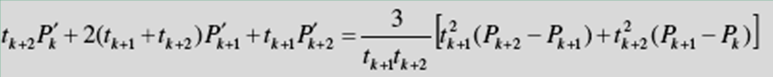
P '+4P + P
For curvature Continuity:
' '
= 3[P − P ]
k k +1 k +2
k +2
k
For three control points (knots) this works as:
'
'
'
P = [3(P − P ) − P − P ] / 4;
In general:
2
3 1 1
3
For N points ??
For 3 points – 1 Eqn. (& 1 unknown)
For 4 points – 2 eqns. (& 2 unknowns)
.
.
.
For N points – (N-2) eqns. (& N-2 unknowns)
Write the eqn. set for N = 5; in matrix form.

Slide 40
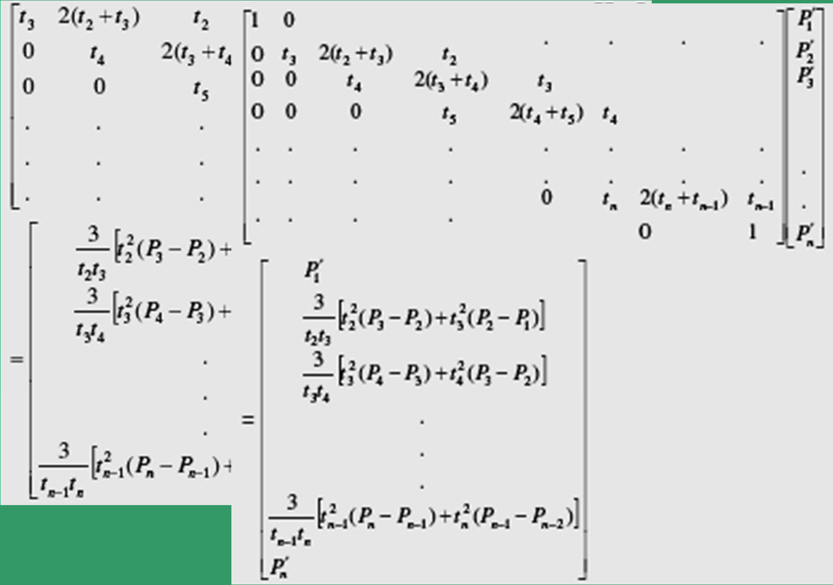
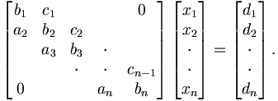
Solve using: Forward- backward substitution:
Thomas Algm.

Slide 41
P '
+4P
'
P
'
= 3[P − P ]
Lets solve for N = 4;
k
k +1
k +2
k +2
k
P '
+4P +
' '
P = 3[P − P ];
1
2
3 3 1
'
'
P '+4P +
P
= 3[P − P ]
Re-arrange to get:
2
3
4
4
2
⎡4 1⎤⎡_{P}' ⎤ ⎡
⎢
3(P −
P ) − P
'
⎤
1 ⎥;
⎥⎢ ² ⎥ ⁼ ⎢
3
1
⎣1 4
'
'
⎦
P 3(P −
P ) − P
4 ⎦
⎣ ³ ⎦ ⎣
4
⎡ 4 −1 ⎡
2
⎡ ⎤
⎤
P
'
⎤
3(P −
P ) − P
'
2 ⎥
1
1 ⎥
⎢
_{P}'
= ( ₁₅)⎢
⎥⎢
3
1
⎣−1 4
⎦
3(P −
P ) − P
'
⎣ ³ ⎦
⎣ 4 2 4 ⎦
Problem:
The position vectors of a normalized cubic
spline are given as (0 0), (1 1), (2 -1) and (3 0).
The tangent vectors at the ends are both (1 1).
Soln:
The 2 internal tangent vectors are
calculated, and both are equal to (1 –0.8).

Slide 42
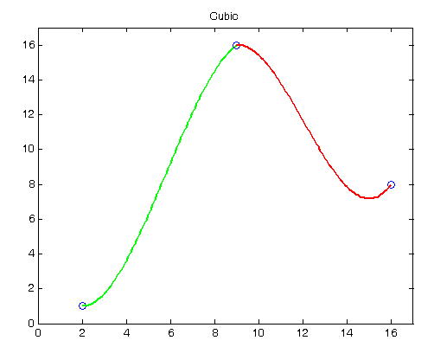
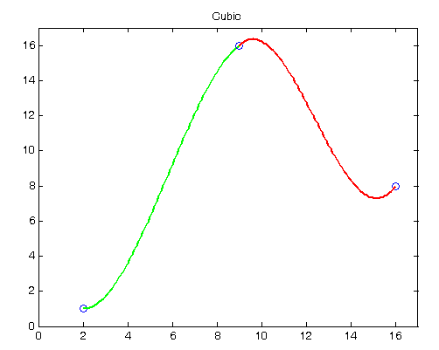
No use of 2nd derivative smoothing
Two piecewise cubic spline segments
Using 2nd
derivative smoothing

Slide 43
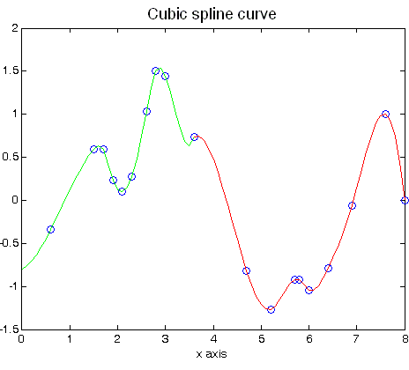
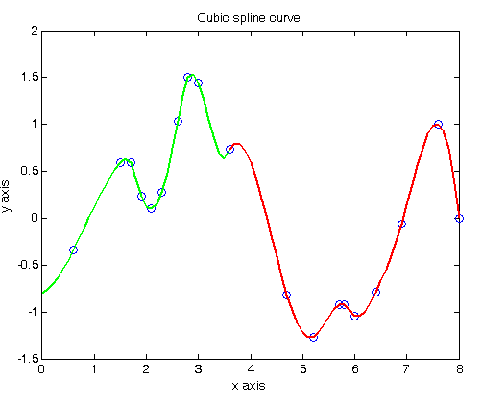
No use of 2nd derivative smoothing
Examples of spline interpolation
Using 2nd derivative smoothing

Slide 44
Other Variants:
Cardinal Splines;
Catmul-Rom splines
Irvine-Hall Splines
T-spline
B-spline

Slide 45
BEZIER CURVES
Basis functions are real
Degree of polynomial is one less than the number of points
Curve generally follows the shape of the defining polygon
First and last points on the curve are coincident with the first and last points of the polygon
Tangent vectors at the ends of the curve have the same directions as the respective spans
The curve is contained within the convex hull of the defining polygon
Curve is invariant under any affine transformation.

Slide 46
A few typical examples of cubic polynomials for Bezier

Slide 47
BEZIER CURVES
B₁
B₂
B₀
B₃
Equation of a parametric Bezier curve:
P(t) = ∑ B_{i} J_{n,i} (t); 0 ≤ t ≤ 1
i=0
n
B_{i}’s are called the control points;

Slide 48
where the Bezier or Bernstein basis or blending function is:
Binomial Coefficients:
(ith, nth-order Bernstein basis function)
J (t) = ^{⎛ n ⎞ i} (1− t)^{n−i} ;
⎜ ⎟t
i
n,i
⎝ ⎠
n! i!(n − i)!
⎛ ^{n} ⎞
⎜ ⎟ =
⎝ ^{i} ⎠

Slide 49
J_{n,i}(t) is the ith, nth order Bernstein basis function.
n is the degree of the defining Bernstein basis function (polynomial curve segment).
This is one less than the number of points used in defining Bezier polygons.

Slide 50
P(t) = ∑ B_{i} J_{n,i} (t); 0 ≤ t ≤ 1
i =0
n
J (t) = ^{⎛ n⎞ i} (1− t)^{n−i} ;
⎜ ⎟t
i
n,i
⎝ ⎠
n! i!(n − i)!
Limits for
i = 0 :
0⁰=1; 0! = 1
⎛ ^{n}⎞ ₌
⎜ ⎟
J ( 0 ) = ^{n!} 0⁰ (1− 0 )^{n−0} = 1;
⎝ ^{i} ⎠
n,0
0!n!
n! i!(n − i)!
For
i ≠ 0:
J ( 0 ) =
0^{i} (1− 0 )^{n−i} = 0;
n,i

Slide 51
Also:
Thus:
J_{n,n}(1 ) = 1,i = n;
J_{n,i} (1 ) = 0,i ≠ n.
P( 0 ) = B₀ J_{n,0}( 0 ) = B₀ .
P(1 ) = B_{n} J_{n,n}(1 ) = B_{n} .
For any t:
∑ J_{n,i} (t) = 1
i=0
n
Also Verify:
J_{n,i} (t) =
(1 − t).J _{( n−1),i} (t) + t.J _{( n−1),(i −1)} (t); n > i ≥ 1

Slide 52
Below are some examples of BBF (Bezier /Bernstein blending functions:
1
^{J}3,0
^{J}3,1
^{1 J}2,0 J
J
^{J}3,3
2,1
2,2
^{J}3,2
1
1/3 0.5 2/3 ₁
t ->
0
t ->
0
n = 2
n = 3 (cubic)

Slide 53
⎛ ^{n} ⎞ ₌
⎜ ⎟ n!
i i!(n − i)!
⎜ ⎟
i
J (t) = ^{⎛ n ⎞}t ^{i}( 1 − t)^{n − i} ;
n,i
⎝ ⎠
⎝ ⎠
Take n = 3:
⎛ ^{n}⎞ ⎛³⎞
6
i!( 3 − i)!
⎜ ⎟ = ⎜ ⎟ =
J (t) = 1.t ⁰ (1− t)³ = (1− t)³ ;
J J J
⎝ ^{i} ⎠ ⎝ ^{i} ⎠
3,0
2
(t) = 3.t.(1− t) ;
3,1
(t) =
(t) = t .
2
3.t .(1− t);
3,2
3,3
3

Slide 54
P(t)
3
2 2
= (1− t) B + 3t(1−
t) B + 3t (1− t)B + t ³ B
0
1
⎡ 1 3 − 3
⎢ 3 − 6 3
⎢− 3 3 0
⎢ 1 0 0
2 3
Thus, for
¹⎤⎡^{B}₀ ⎤
Cubic
₀⎥⎢ _{B} ⎥
[ t ]
Bezier: _{= t} ³
_{t} 2
₁ ⎢
⎥⎢
^{1 ⎥};n = 3.
₀⎥⎢_{B2} ⎥
₀⎥⎢_{B} ⎥
⎣
⎦⎣ ³ ⎦
P(t) = T .N .G =
For
⎡ 2 − 2 1 1 ⎤⎡ P_{k}
⎢− 3 3 − 2
0 1
0 0
T
Cubic-splines:
⎤
⎥
= [
_{t} 3 _{t} 2
]
− 1⎥ ⎢ P
k +1 ⎥
t
₁ ⎢
⎥⎢
⎢ ₀
⎢ ₁
₀ ⎥⎢ _{Pk '} ⎥
₀ ⎥⎢_{P '}⎥
⎣
⎦⎣ ^{k +1} ⎦

Slide 55
For n = 4:
⎡ 1 − 4 | 6 | − 4 1⎤⎡B_{0 ⎤}
⎢− 4 12 | − 12 | 4 0⎥⎢B ⎥ ⎥⎢ ¹ ⎥
P(t) = [t ⁴ t ³ t ² t 1]⎢ 6 − 12 | 6 | 0 0⎥⎢B₂ ⎥
⎢− 4 4 | 0 | ₀ ⎥⎢_{B} ⎥ ⁰⎥⎢ ³ ⎥
⎢⎣ 1 0 | 0 | ^{0 0⎥}⎦⎢⎣^{B}4 ⎥⎦
= T.N.G = F.G;
⎢
⎢
where:
F = [J_{n,o}(t) J_{n,1}(t) ....... J_{n,n}(t)]
N = [λ ]
ij
nxn

Slide 56
where:
⎧⎛ ^{n}⎞⎛
n − j
⎞
n−i − j
0 ≤ (i + j) ≤ n
λ = ⎪⎜ j ⎟⎜ n − i − j ^{⎟(−1)}
⎨⎝
⎠⎝ ⎠
ij
⎪₀
⎩
otherwise

Slide 57
⎜ ⎟t
J
n,i
⎝ ⎠
n! i!(n − i)!
i
⎛ ^{n} ⎞
⎜ ⎟ =
⎝ ^{i} ⎠
Computation of
successive binomial coefficients:
⎛ ^{n}⎞ ⎛ ^{n} ⎞
n − i +1
i
⎜ ⎟ = ( )⎜ ⎟
⎝ ^{i} ⎠
⎝ i −1⎠
Home Assignment:
Get the expressions of J_{2,i}
and J_{4,i}

Slide 58
Bezier Basis Functions
1.2
1
0.8
0.6
0.4
0.2
0
 | ^{J}3,0
 | ^{J}3,1
 | ^{J}3,2
 | ^{J}3,3
B0
B1 B2 B3

Slide 59
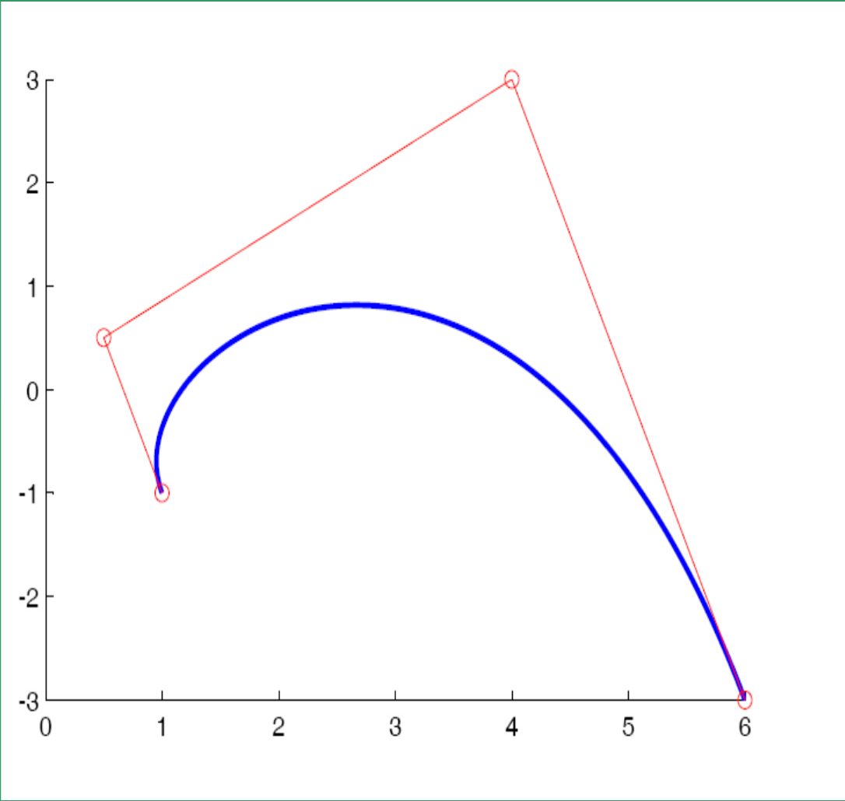
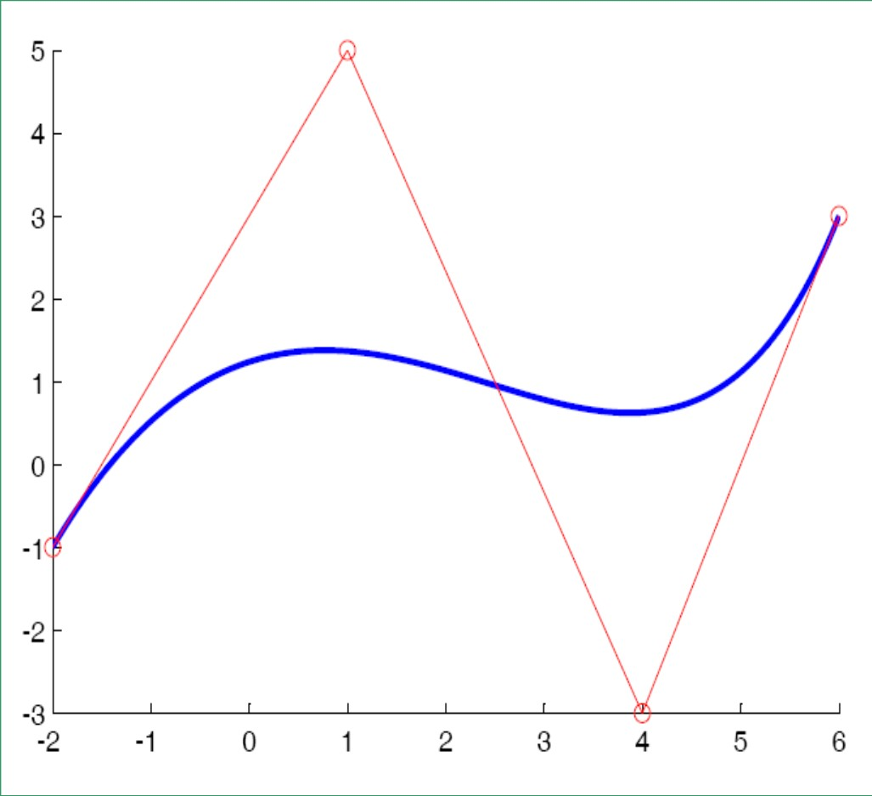
Bezier Curve Examples

Slide 60


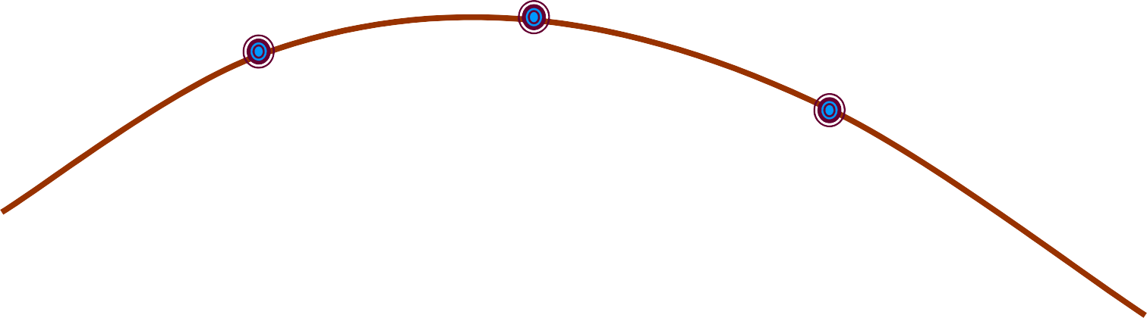




Recursive geometric definition of BEZIER CURVES
P₁
P₀
P₂
If, N > 3 ??

Slide 61
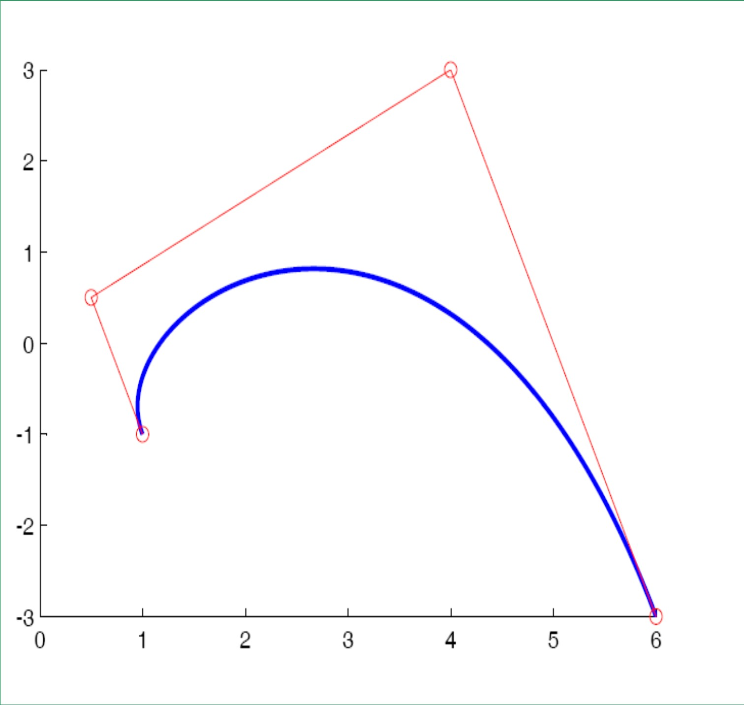







Recursive Bezier Curve Example

Slide 62
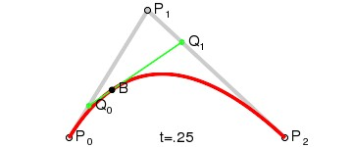
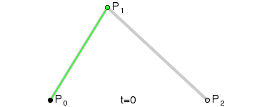
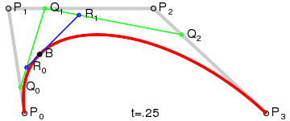
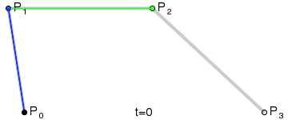
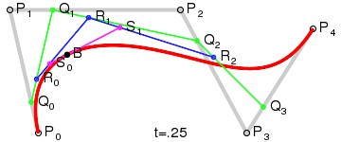
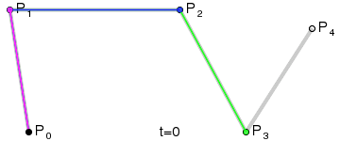
Iterative Bezier Curve Animation

Slide 63
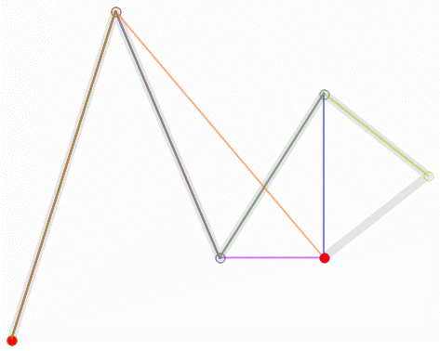
Iterative Higher-order Bezier Curve Animation

Slide 64
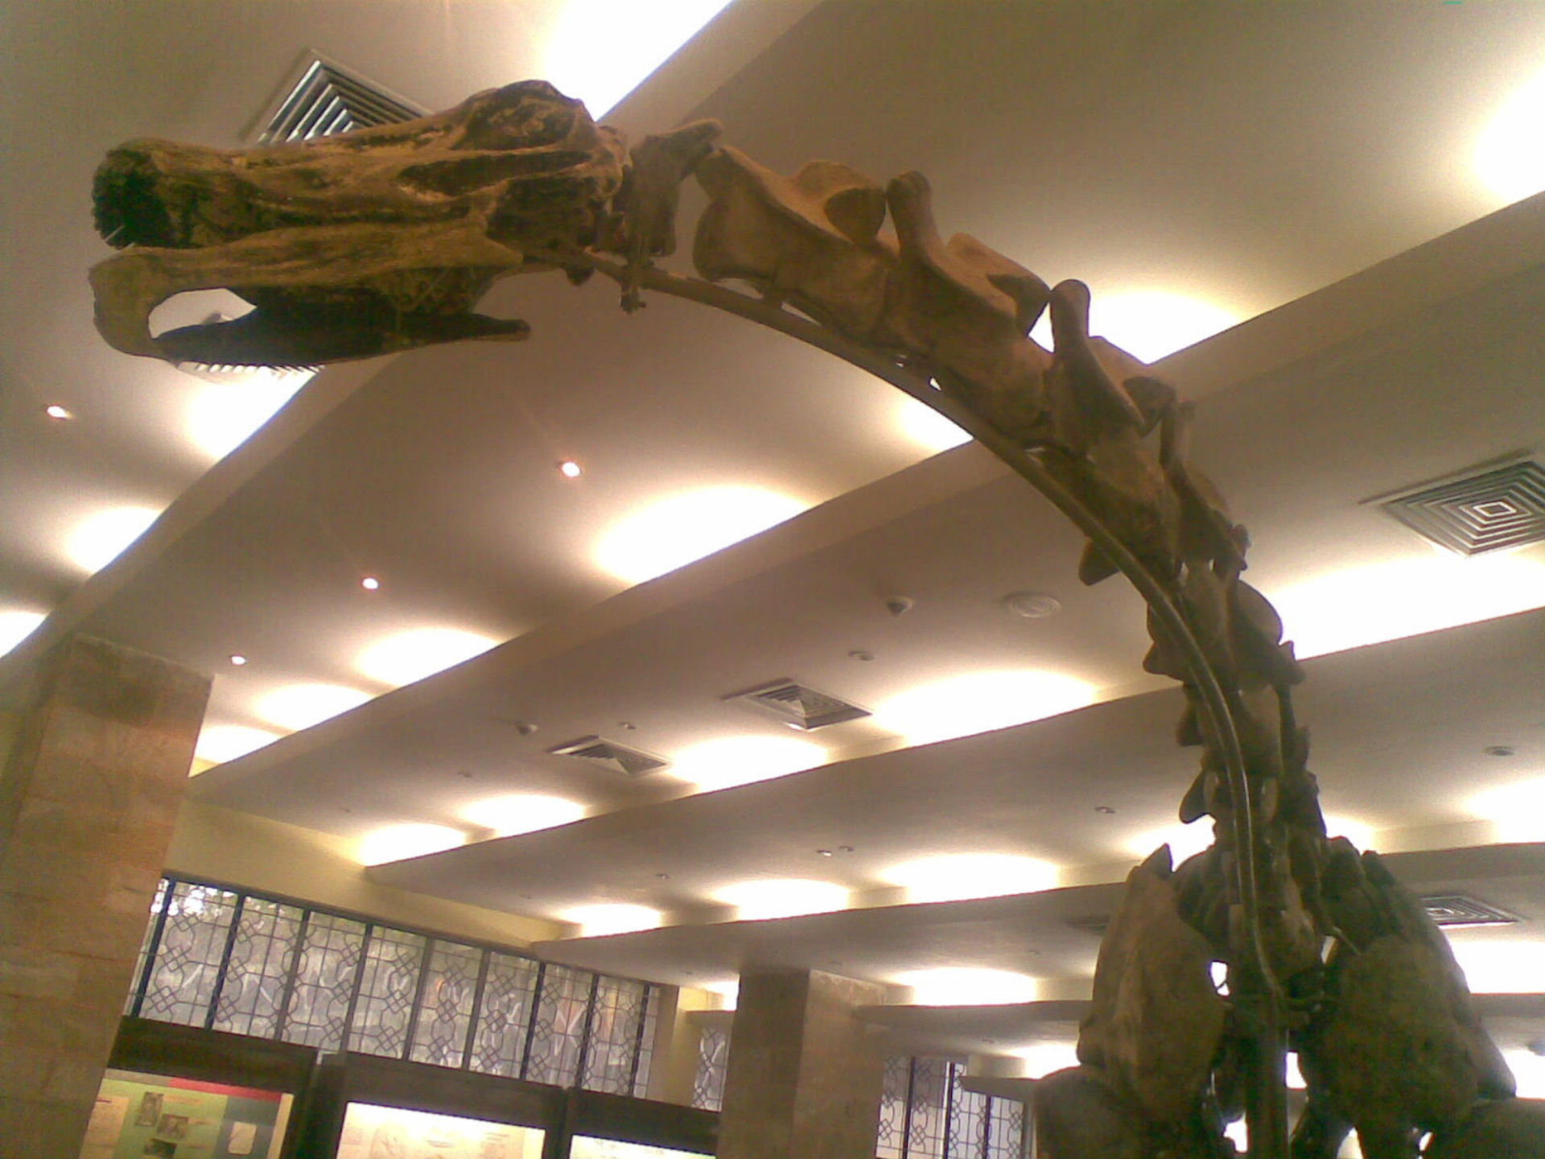

Slide 65
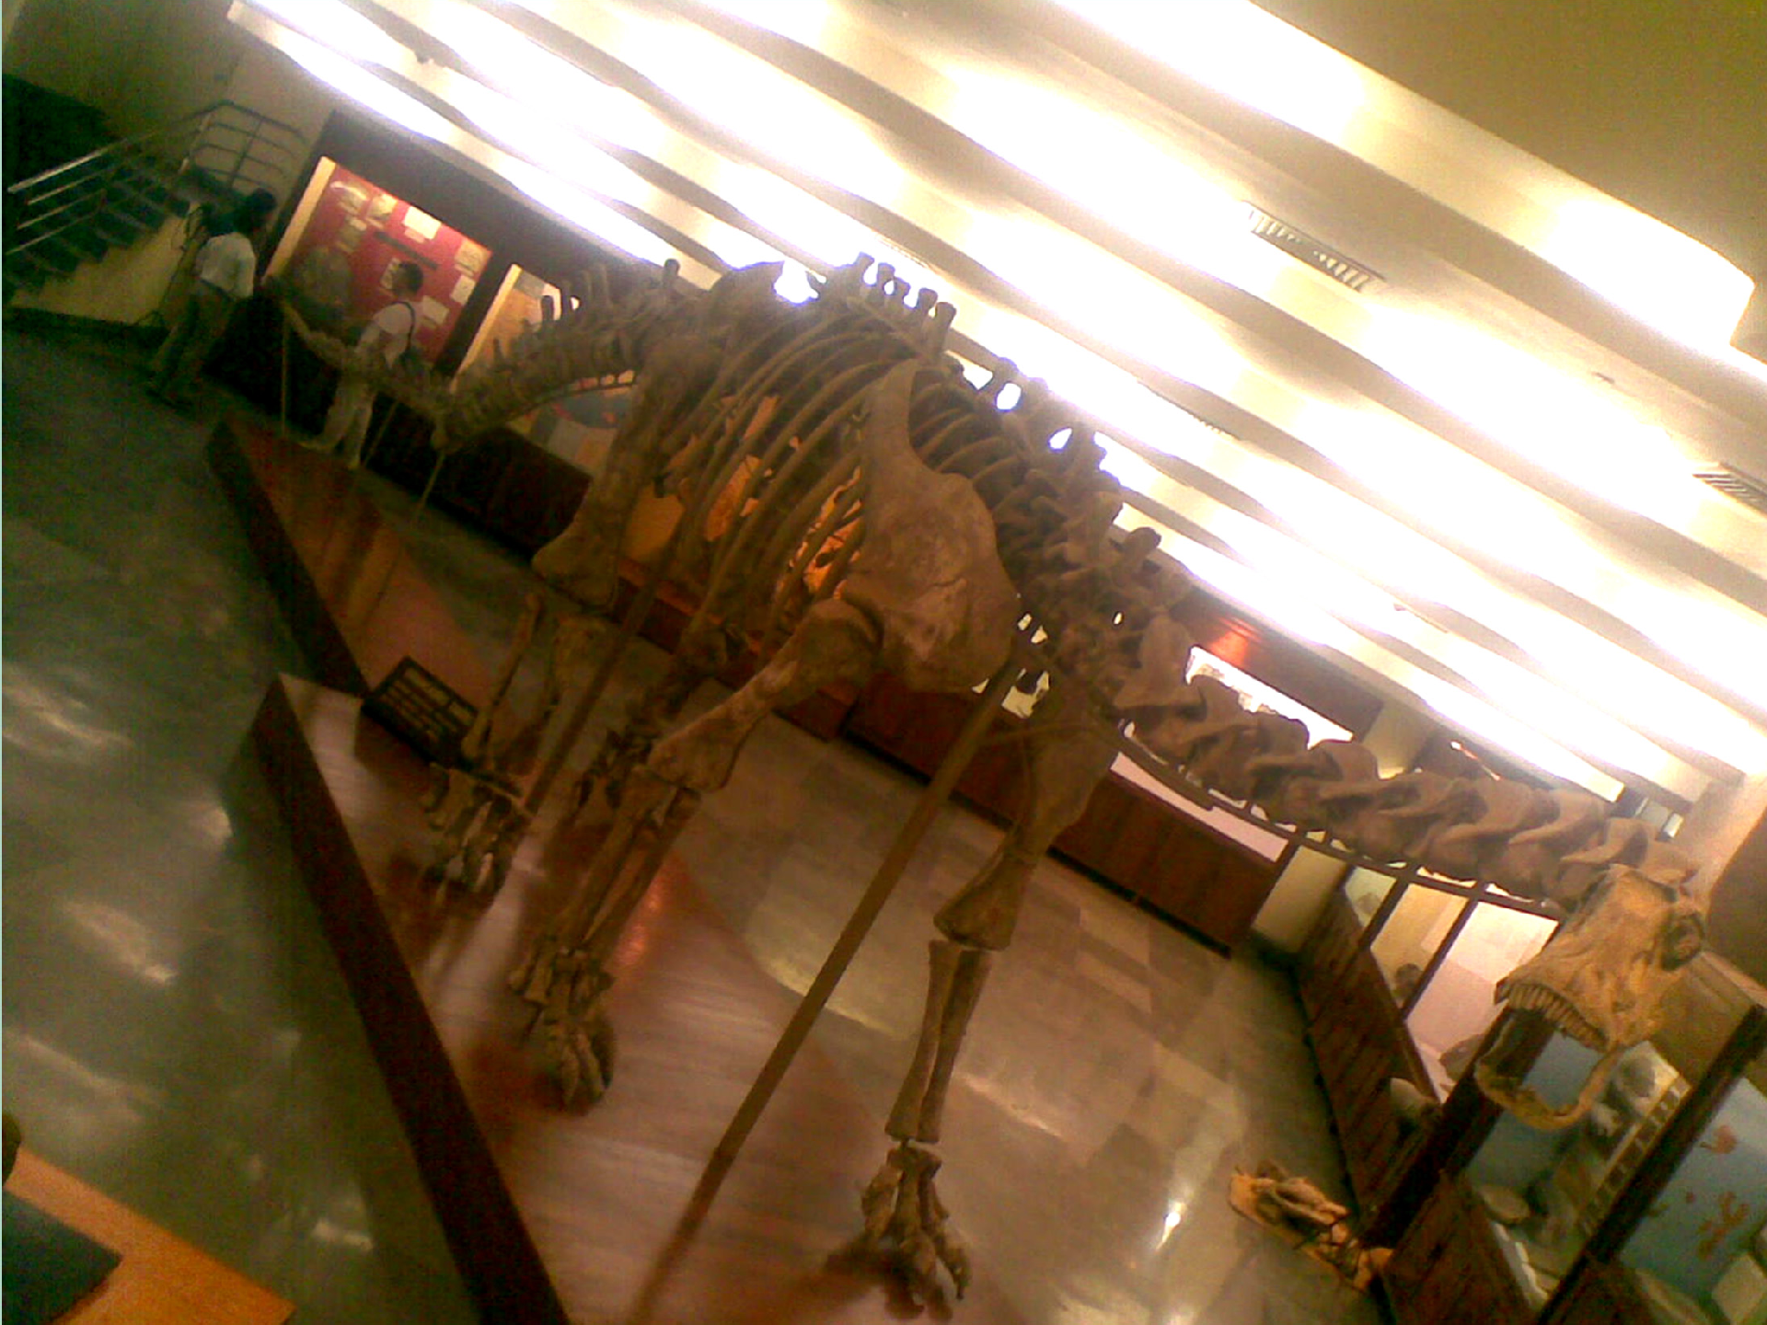

Slide 66
More to follow:
B-splines represented as blending functions
Conversion between one format to another.
Knots and control points.
When B-spline becomes a Bezier?
QUADRICS – 3-D analogue of conics:

Slide 67
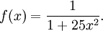
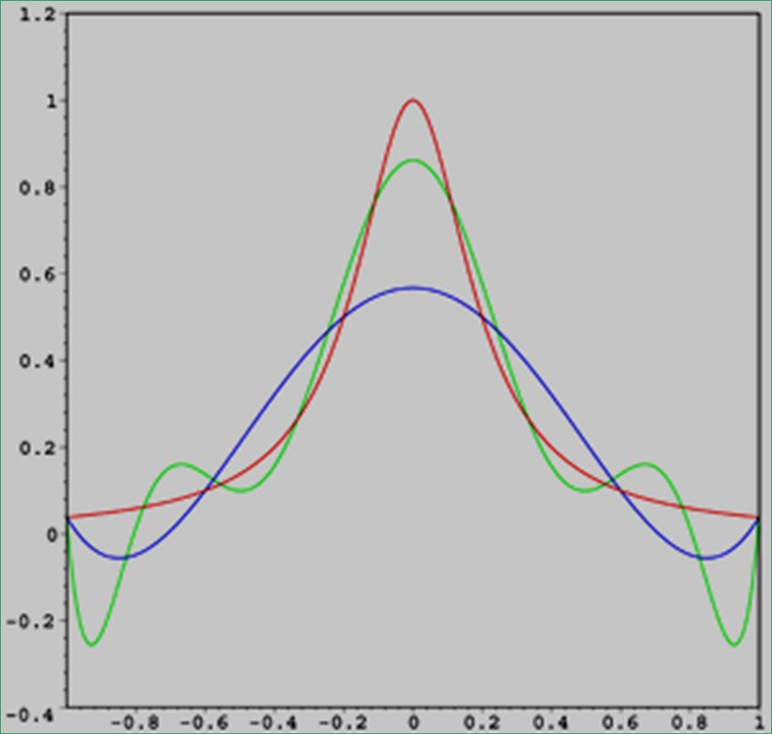
Basis Splines (B-splines):
- a generalisation of a Bézier curve, avoids the Runge phenomenon without increasing the degree of the B-spline
The red curve is the Runge (The Cauchy–Lorentz distribution or Breit–Wigner distribution) function.
The blue curve is a 5th-order interpolating polynomial (using six equally-spaced interpolating points).
The green curve is a 9th-order interpolating polynomial (using ten equally-spaced interpolating points).
At the interpolating points, the error between the function and the interpolating polynomial is (by definition) zero.
Between the interpolating points (especially in the region close to the endpoints 1 and
−1), the error between the function and the interpolating polynomial gets worse for higher-order polynomials.

Slide 68
Limitations of Bezier Curves:
Not enough flexibility
Higher degree with more No. of control points
Larger degree has instability, numerical errors, and computational costly
Not enough local control (global effect of change).
-

Slide 69
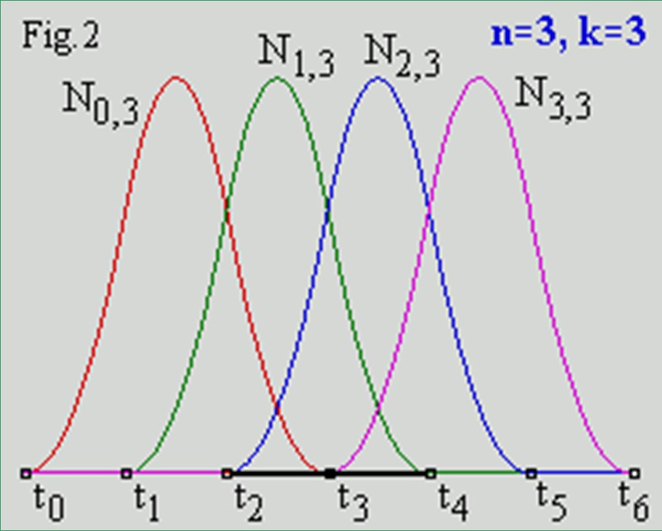
In mathematics, a spline is a special function defined piece- wise by polynomials.
Spline interpolation is often preferred to polynomial interpolation because it yields similar results, even when using low-degree polynomials, while avoiding Runge's phenomenon
Periodic uniform B-spline
basis, with k= 3, p = 3;
for higher degrees.
Uniform Knots: [0 1 2 3 4 5 6];
N_{i,k} (i-th B-spline blending function, of order k) is a polynomial of order k (degree k-1) on each interval:
t_{i} < t < t_{i+k}.
k must be at least 2 (linear) and can be not more, than p+1 (the number of control points = n in Fig. above).
A knot vector (t₀ , t₁ , ... , t_{p+k}) must be specified.
Across the knots basis, functions are C ^{k-2} continuous.

Slide 70
The form of a B-spline curve is very similar to that of a Bézier curve. However, unlike a Bézier curve, a B-spline curve involves more information, namely:
a set of p control points,
a knot vector of m knots, and
a degree n (i.e. order n+1).
Note that n, m and p must satisfy m = n + p + 1.
More precisely, if we want to define a B-spline curve of degree
n with p control points, we have to supply n + p + 1 knots:
t₀, t₁, ...., t_{n+p+1}.
On the other hand, if a knot vector of m knots and p control points are given, the degree of the B-spline curve is:
n = m - p – 1 or m – (p+1).

Slide 71
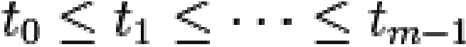
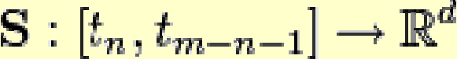
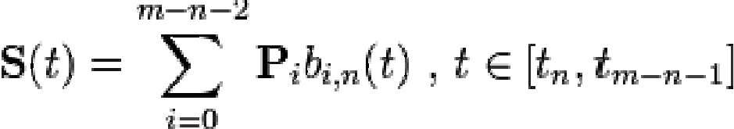
Basis Splines (B-splines):
Degree is independent of the No. of control Points
Local Control over Shape
More complex than Bezier
Given m values , called knots, with
a B-spline of degree n is a parametric curve
composed of linear combination of basis B-splines b_{i,n}
( of degree n):
1 ≤ n ≤ p;
/ * unnecessary
The P_{i} are called control points or de Boor points (there are m-n-1 control points). A polygon can be constructed by connecting the de Boor points with lines, starting with P₀ and finishing with P_{m−n−2}. This polygon is called the de Boor polygon.

Slide 72
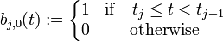
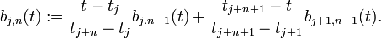
The m-n-1 basis B-splines of degree n
for n = 0,1,...,(m-2), can be defined using the Cox-de Boor recursion formula:
j = 0,1,...,(m-2)
^{t ∈[t} j ,^{t} j +n+1 ]
j = 0,1,...,(m-n-2)
(j+n+1) can not exceed m-1, which limits both j and n.
The above recursion formula specifies how to construct nth- order function from two B-spline function of order (n-1).
No. of Control Points: (m – n - 1);
(m-n-1=4=n+1; n=3) - If B-
Degree of Spline: n;
spline has [0 0 0 0 1 1 1 1] knot
vector, we get Bezier basis.
No. of Knots: m ( = No. of Control Points + degree + 1);

Slide 73
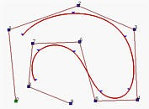
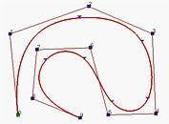
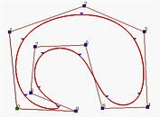
B-splines
^{OPEN} CLOSED
CLAMPED
The above figures have p control points (p=10) and n =
3. Then, m must be 14, so that the knot vector has 14 knots.
To have the clamped effect, the first n+1 = 4 and the last 4 knots must be identical. The remaining 14 - (4 + 4) = 6 knots can be anywhere in the domain (giving non-periodic structure).
In fact, the central curve is generated with knot vector:
U = { 0, 0, 0, 0, 0.14, 0.28, 0.42, 0.57, 0.71, 0.85, 1, 1, 1, 1 }.
Note that except for the first four and last four knots, the middle ones are almost uniformly spaced. In fact, the little triangles are the knot points. Periodic structure gives closed curves. Avoid multiplicty at ends for open unclamped curves.

Slide 74
The “Standard Knot Vector” for a B-spline of order (n + 1) begins and end with a knot of “multiplicity” (n+1) and uses unit spacing for the remaining knots.
Let, No. of control points: m-n-1 = 8; and for a cubic (n=3) B-spline: n + 1 = 4;
So, m = 12; The “Standard Knot Vector” is”
[0 0 0 0 1 2 3 4 5 5 5 5]
Periodic, Cubic B-spline
Blending functions :
B_{0,3}(t) = (1− t)³ / 6;
B_{1,3}(t) = (3.t³ − 6t ² + 4) / 6; B_{2,3}(t) = (−3.t³ + 3t ² + 3t +1) / 6; B_{3,3}(t) = t³ / 6.
B_{i,n}(t) is non-zero only in
the interval:
^{t ∈[t}i,^{t}i+n+1 ]
Hence it spans the knots:
^{t}i,^{t}i+1,^{t}i+2,......,^{t}i+n+1 ]

Slide 75
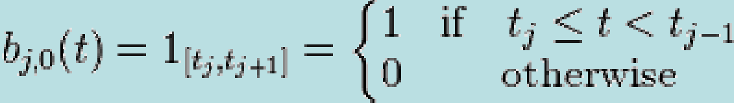
The recursion for integer knots
(n) B _{jn} (t ) =
(t − j) B _{j ,n −1} (t ) + (n + 1 + j − t ) B _{j +1,n −1} (t )
Lets solve for, the B-spline function of order 2 (degree n=1) beginning at n=0, the recursion is ??
B₀₁ (t ) =
tB₀₀ (t ) + (2 − t ) B₁₀ (t )
Degree is “n” and order is “m” = n + 1.

Slide 76
Now Plot B₀₁(t) from Two Boxes B₀₀(t) and B₁₀(t)
1
0.8
0.6
0.4
0.2
0
xB₀₁(x) and (2-x)B₁₁(x)
0
0.2
0.4
0.6
0.8
1
1.2
1.4
1.6
1.8
2
1
0.8
0.6
0.4
0.2
0
xB₀₁(x) + (2-x)B₁₁(x)
0
0.2
0.4
0.6
0.8
1
1.2
1.4
1.6
1.8
2
B₀₁(t) is a tent function

Slide 77
knots:
ξ₀, ξ₁, …, ξ_{L}.
1
0.8
0.6
0.4
0.2
0
B-splines of order 2 are tent functions, starting at a knot,
-0.2
-5 -4
-3 -2
-1
0
1
2
3
4
5
rising linearly to 1 at the next knot, and decaying linearly to 0 two knots over.
1
0.9
0.8
0.7
They (B_{0,1} & B_{1,1}) are
0.6
0.5
continuous.
0.4
Order 2 implies a continuous
0.3
derivative of order 0.
0.2
0.1
Order 2 knots are piecewise
0
0
0.5
1
1.5
2
2.5
3
linear

Slide 78

Order 3 - B₀₂(t) from Two Tent Functions
3 − t
B_{0,2} (t) = ( ^{t} )B (t) + B (t)
2
0,1 1,1
2
t.(2 − t)
??
(3 − t)(t −
(3 − t)²
(n) B _{jn} (t ) = (t − j) B _{j ,n −1} (t ) + (n + 1 + j − t ) B _{j +1,n −1} (t )
1)

Slide 79



Slide 80




Joints: Values of functions at adjacent segments;
Knot – Values of t, where segments meet

Slide 81




Constant B-spline:
Linear B-spline:
Uniform quadratic B-spline (uniform knot vector):
_{←=} − 2t ² + 6t − 3
2
V = [1, 2, 3, 4, 5, 6];
Above, when reparameterized in the unit interval:

Slide 82


B_{0,3}(t) = (1− t)³ / 6;
B_{1,3}(t) = (3.t³ − 6t ² + 4) / 6; B_{2,3}(t) = (−3.t³ + 3t ² + 3t +1) / 6; B_{3,3}(t) = t³ / 6.

Slide 83


B-Spline Examples
Order 4, Degree 3, Knots = 5, Poly pieces = 4.
Order 5, Degree 4, Knots = 6, Poly pieces = 5.

Slide 84

A B-Spline of Order 4, and the Four Cubic Polynomials from which it is made.
Knot Sequence: [0 1 2 3 4]

Slide 85

A B-Spline of Order 4, and the Four Cubic Polynomials from which It Is Made
Knot Sequence: [0 1.5 2.3 4 5]

Slide 86





When the knots are equidistant we say the B- spline is uniform, otherwise we call it non-uniform.
NURBS: Non-uniform Regularized B-Splines Uniform B-spline
When the B-spline is uniform, the basis B-splines for a given degree n are just shifted copies of each other. An alternative non-recursive definition for the m−n-1 basis B-splines is:
with
When the number of Control points is the same as the order, the B-Spline degenerates into a Bézier curve.
and
where
The shape of the basis functions is determined by
is the truncated power function. ^{the position of the knots.}

Slide 87


Slide 88

For Bezier:
⎡ 1 3 − 3
− 6 3
¹⎤⎡^{B}₀ ⎤
P(t) = [t³ t 1]
⎢ ₃
₀⎥⎢ _{B} ⎥
_{t} 2
⎢
⎥⎢
^{1 ⎥};n = 3.
⎢− 3 3 0
⎢
⎣ 1 0 0
⎡ 2 − 2 1 1 ⎤
⎢ ⎥
^{t 1]⎢} 0 0 1 0 ⎥
_{2 ⎢} − 3 3 − 2 − 1⎥
⎢ ⎥
₀⎥⎢_{B2} ⎥
B (t) = (1− t)³ / 6;
0,3
₀⎥⎢_{B} ⎥
⎦⎣ ³ ⎦
B (t) = (3.t³ − 6t ² + 4) / 6;
For
1,3
⎤ T
Cubic-splines: _{B}
⎡
P
(t) = (−3.t³ + 3t ² + 3t +1) / 6;⎢
k
⎥
P ( t ) = [t ³ t
2,3
⎢ ^{P}k + 1 ⎥
⎢ P_{k} ' ⎥
B_{3,3}(t) = t³ / 6.
⎣
For reparameterized
1
0
0
0 ⎦ ^{⎢ P '⎥}
⎣ ^{k + 1} ⎦
Cubic B-splines, with uniform Knot vector:

Slide 89

4
3
P(t) = ∑ B _{i} t ;t
i − 1
i
i = 1
P (u ) = ∑ g_{k} H _{k} (u )
≤ t ≤ t ₂ .
k =0
+ 1 ) + P₂ ( − 2 t ³ + 3 t ² )
P ( t ) = P₁ ( 2 t ³ − 3 t ²
' 3
' 3 _{− t} 2 ₎ ^{CUBIC SPLINES}
2
P
( t − 2 t ² + t ) + P
( t
1
n
P(t) = ∑ B _{i} J _{n,i} (t) ;
BEZIER CURVES
0 ≤ t ≤ 1
i = 0
^{⎛ n ⎞ ⎛ n ⎞} n!
J _{n,i} (t) = ⎜ ⎟t ^{i}( 1 − t)^{n − i} ;⎜ ⎟ =
⎝ ^{i} ⎠
⎝ ^{i} ⎠
i!(n − i)!
B-splines
j = 0,1,...,m-2
j = 0,1,...,m-n-2

Slide 90

1.2
1
0.8
B0 B1
B2 B3
0.6
0.4
0.2
0

Slide 91


Slide 92


Slide 93



Slide 95
QUADRIC SURFACES
Some trivial examples:
(x − a)² + ( y − b)² + (z − c)² = r² ;
x = r.cosφ.cosθ , −^{π} ₂ ≤ φ ≤ ^{π} ₂
y = r.cosφ.sinθ , −π ≤ φ ≤ π
z = r.sinφ.
SPHERE

Slide 96
( ^{x} )² + ( ^{y} )² + ( ^{z} )² = 1;
a b c
ELLIPSOID
x = a.cos φ.cosθ , − ^{π} ₂ ≤ φ ≤ ^{π} ₂
y = b.cos φ.sin θ , − π ≤ φ ≤ π
z = c.sin φ.
_{2 ⎤}2
⎡
2
z
_{⎢r −} ⎛ ^{x} ⎞ ₊⎛ ^{y} ⎞ ⎥
2
⎢ ⎜ _{a} ⎟ ⎜ _{b} ⎟
+ ( ) =1;
c
TORUS
⎝ ⎠ ⎝ ⎠ ⎥⎦
⎣
x = a.(r + cosφ).cosθ, −π ≤ φ ≤ π y = b.(r + cosφ).sinθ, −π ≤ φ ≤ π z = c.sinφ.

Slide 97

SUPERELLIPSOID
x
2
y
2
s₂
s_{2 ]} s₁
z
2
s₂
s₁
[( ) + ( ) + ( ) = 1;
a b c
x = a.cos^{s1} φ.cos^{s2} θ , − ^{π} ₂ ≤ φ ≤ ^{π} ₂
y = b.cos^{s1} φ.sin^{s1} θ , − π ≤ φ ≤ π
z = c.sin s₁φ.
SUPERQUADRICS:

Slide 98
General expression of a Quadric Surface
Ax ² + By ² + Cz ² + Dxy + Eyz + Fxz
Gx + Hy + Jz + K = 0.
The above is a generalization of the general conic equation in 3-D. In matrix form, it is:
XSX^{T} = 0,
⎡2A D F
2B E
E 2C J ⎥ ⎢ z ⎥ H J 2K ⎥ ⎢1⎥
^{G} ⎤ ⎡ ^{x}⎤
⎢ _{D}
_{H} ⎥ ⎢ _{y}⎥
⇒ [x y z 1](1/2)⎢
⎥ ⎢ ⎥ ₌ ₀
⎢ _{F}
⎢ _{G}
⎣
⎦ ⎣ ⎦

Slide 99
Parametric forms of the quadric surfaces, are often used in computer graphics
Ellipsoid :
x = a cos(θ ). sin( φ ); 0 ≤ θ ≤ 2π ; y = b sin(θ ). sin( φ ); 0 ≤ φ ≤ 2π ; z = c cos( φ );
Elliptic Cone :
x = aφ cos(θ ); 0 ≤ θ ≤ 2π
y = bφ sin(θ ); φ_{min} ≤ φ ≤ φ_{max}
z = cφ
Elliptic Paraboloid :
x = aφ cos( θ ); 0 ≤ θ ≤ 2π
y = bφ sin( θ ); 0 ≤ φ ≤ φ_{max}
z = φ ²
Hyperbolic Paraboloid :
x = aφ cosh(θ ); − π ≤ θ ≤ π
y = bφ sinh( θ ); φ_{min} ≤ φ ≤ φ_{max}
z = φ ²
Hyperboloi d:
x = a cos(θ ) cosh(φ ); 0 ≤ θ ≤ 2π y = b sin(θ ) sinh(φ ); − π ≤ φ ≤ π z = sinh(φ )
Parabolic Cylinder :
x = a θ ² ; 0 ≤ θ ≤ θ _{max}
y = 2 a θ ; φ _{min} ≤ φ ≤ φ _{max}
z = φ

Slide 100





Some examples of Quadric Surfaces
Hyperboloid
Parabolic Cylinder
Elliptic Paraboloid
Hyperbolic Paraboloid

Slide 101
BEZIER Surfaces
Degree of the surface in each parametric direction is one less than the number of defining polygon vertices in that direction
Surface generally follows the shape of the defining polygon net
Continuity of the surface in each parametric direction is two less than the number of defining polygon net
Only the corner points of the defining polygon net and the surface are coincident
The surface is contained within the convex hull of the defining polygon
Surface is invariant under any affine transformation.

Slide 102
⎛ ^{n}⎞
Equation of a parametric Bezier surface:
J_{n,i}(u) = ⎜⎜ ⎟⎟u^{i}( 1 − u)^{n−i} ;
⎝ ^{i} ⎠
⎛ ^{n}⎞
n!
Q(u, w) =
⎜ ⎟ ₌
i i!(n − i)!
⎝ ⎠
n m
^{∑∑ P}i , j ^{J}n,i ^{(u)K}m , j ^{(w);}
i =0 j =0
⎛ ^{m} ⎞
K (w) =
⎜ ⎟
⎝ ⎠
w ( 1 − w) ;
j
m− j
m,j
j
⎛ ^{m} ⎞
m!
⎜ ⎟ ₌
j j!(m − j)!
⎝ ⎠

Slide 103


BEZIER Surfaces
n m
Q(u, w) = ∑∑ P_{i , j} J_{n,i} (u)K_{m , j} (w)
i =0 j =0
n m
= ∑ [∑ P_{i , j} J_{n,i} (u)] K_{m , j} (w);
i =0 j =0

Slide 104
BEZIER Surface in matrix form:
Q(u, w) = U .N .B.M^{T}W ;
where,
U = [u^{n}
W = [w^{m}
^{⎡ B}0,0
_{u}n−1
_{w}m −1
. . 1],
. . 1]^{T} ,
. .
. . . .
. . . .
. . B
^{B}0,m ⎤
⎥
⎢
B = ⎢
⎥
⎥
⎢
⎢_{B}
⎥
⎣
n,m ⎦
n,0

Slide 105
Q(u, w) =
4x4 bicubic BEZIER Surface in matrix form:
⎡ 1 3 − 3
− 6 3
⎢− 3 3 0
⎢ 1 0 0
^{B}0,1 ^{B}0,2
₀⎥⎢B B B
1,0 1,1 1,2
^{B}2,1 ^{B}2,2
3,1 3,2
^{1⎤⎡B}0,0
^{B}0,3 ⎤
⎢ ₃
[u³ u 1]⎢
⎥⎢
^{B}1,2 ⎥
_{u}2
⎥
^{0⎥⎢B}2,0
^{B}2,3 ⎥
⎥⎢_{B}
⎥
⎣
⎡ 1 3 − 3
⎢ 3 − 6 3
⎢− 3 3 0
⎢ 1 0 0
0⎦⎣⎢
B B B
⎥
3,0
3,3
⎦
¹⎤⎡^{w3} ⎤
₀⎥⎢_{w2} ⎥
_{X}⎢
⎥⎢ ⎥;
₀⎥⎢ _{w} ⎥
⁰⎦⎣ ¹ ⎦
⎥⎢ ⎥
⎣

Slide 106
Q(u, w) =
⎡ 1 − 4 6 − 4 1⎤
⎢− 4 − 12 − 12 4 ⎥
− 12 6 0 0⎥
⎢− 4 4 0 0 0⎥
0 0 0 0⎦⎥
Non-square
4x4 bicubic
₀⎥
BEZIER
Surface in matrix form:
⎢
[u⁴
_{u}3 _{u}2
u
1]⎢ 6
⎥
⎢
⎢_{⎣ 1}
^{B}0,1 ^{B}0,2 ⎤
⎢B B
1,0 1,1
^{B}2,1
3,1
^{B}4,1
^{⎡B}0,0
− 2
2 0⎥⎢ w ⎥;
0
⎢
^{B}1,2 ^{⎥⎡ 1}
¹⎤⎡^{w2} ⎤
⎥⎢
⎥⎢ ⎥
^{X ⎢B}2,0
^{B}2,2 ⎥⎢⁻ ²
⎢_{B}
⎥_{⎢ 1}
B B
3,2 ⎥⎣
₀⎥⎢ ₁ ⎥
⎢
3,0
⎦⎣ ⎦
⎢⎣^{B}4,0
^{B}4,2 ⎥⎦

Slide 107
∑∑ ^{w}i, j ^{P}i,k ^{B}i,m ^{(u)B}k ,n ^{(v)}
NURBS
M L
Q(u, v) =
i=0 k =0
M L
∑∑ ^{w}i, j ^{B}i,m ^{(u)B}k ,n ^{(v)}
i=0 k =0

Slide 108



